Slide 1
Perovskite material: Strontium Titanate (SrTiO₃)
SrTiO₃ unit cell
In substrate on a basis, it has:
Ferroelectric phase transition at room temperature [1]
Sr
Sr
3,905 Å
Ti
Ti
Polarization
O
O
3,905 Å
Small structural changes are responsible for essential properties.
To understand and/or control these properties, we need:
✓ Surface sensitivity
[1] Haeni, J. H., et al., Nature. 430 7001 (2004).
Notes:
Paraelectric
まず本研究の対象物質について簡単に紹介します。
対象物質は、ペロブスカイトの一種であるチタン酸ストロンチウムです。
チタン酸ストロンチウムは、ストロンチウム原子、チタン原子、酸素原子からなり、常温では左の図の立方晶の単位格子を取ります。
物性の一つとして、基盤上で薄膜にした際に、常温で強誘電体へ転移することが挙げられます。これはTi原子のオフセットによって起きる自発分極が原因であると考えられている（XAS）。
このように、表面の微細な構造の変化が物性を変化させることがわかっていますが、サブÅスケールの構造変化を捉える、制御するためには、表面敏感な解析手法が有望であると考えられている。
Ti原子の変位、実験的観測：
強調版 日本語訳
ペロブスカイト構造結晶のX線Ti K吸収スペクトルにおける**プレエッジ微細構造（PEFS）**について、完全な解釈を提案する。本解釈は、修正版のフル多重散乱法を用いた多数の計算結果に基づいており、この方法により3d遷移金属酸化物に対する理論スペクトルが実験と良い一致を示すことが確認されている。
特に、中央のピークBはp–d混成効果によって生じ、その強度の大きさはペロブスカイト結晶の強誘電性の分光学的指標と考えられる。そして重要なのは、ピークBの面積が格子定数とTi原子の変位量（配位多面体の瞬間的な中心からの平均二乗変位）で直接的に表されるという点である。すなわち、Ti原子のわずかな変位が、分光学的に強誘電性の有無を決定する主要因となる。熱振動で平均化されたピークBの面積は、三体原子分布関数によって決まる。
一方、長波長側のピークAは主に四重極遷移に由来し、短波長側のピークCはTi 1s電子が隣接する遷移金属原子の空の3d状態へ遷移することに由来する。また、短波長側に追加ピークが現れる場合があり、これはZrのような4d原子がTi原子の周囲の酸素八面体に存在する場合に対応し、その面積は近傍4d原子数で決まる。
DyScO3: スカンジウム酸ジスプロシウム
BO3型のペロブスカイト構造と呼ばれる対称性の高い構造をとる。
タイトル、６０
化学
仮数、
polar discontinuity
alternately charged planes [LaO]+and[AlO2]−
AttheTiO2/LaO-terminated LAO/STO interface,therefore, each interfacial La transfers half of an electron intothe neighboring and formally neutral TiO2layer that decreasesthe oxidation state of interfacial Ti
All epitaxially grown perovskite heterostructures containintrinsic oxygen vacancies and substitutional cations near theinterfaces [14,15]. Interfacial defects may induce additionalcharged carriers
So as in the topic.
We are interested in the perovskites esp, Strontium Titanium Oxygen, or STO, because small changes in its structure are responsible for essential properties.
And it is of great technological importance.
The unit cell is a face-centred one, where we have 8 Srs at each vortex, 6 Oxygen at each centre of the faces and 1 Titanium in the centre.
Here is an example of 2-dimensional electron gas formation.
Firstly, on the left we have the iron and the STO layer and interface.
Secondly, oxygen migrates to the iron layer and we have oxidised irons and oxygen vacancies.
And if you look at the unit cell on the right, we have an oxygen vacancy and it causes the titanium to deviate upwards.
However, to understand and control such a property we need accurate crystallographic information, chemical resolution and surface sensitivity and the best way to do that is with X-ray photoelectron diffraction, called XPD.

Slide 2
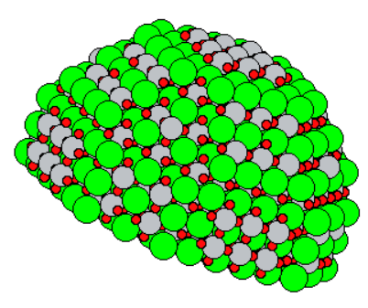
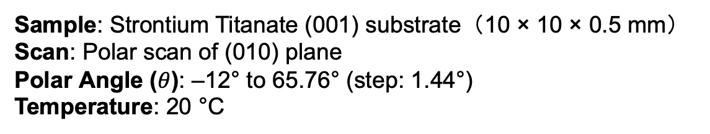
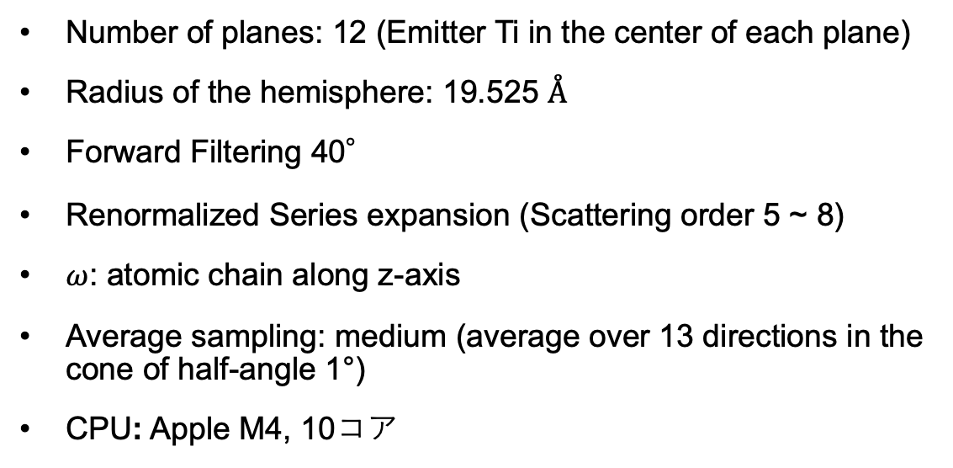
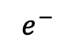
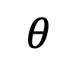
Simulation and experimental setups
XPD polar scan of plane (010) for STO(001)
X-ray
z
$$e^{−}$$
$$θ$$
(010) plane
Number of planes: 12 (Emitter Ti in the center of each plane)
Radius of the hemisphere: 19.525 Å
Forward Filtering 40°
Renormalized Series expansion (Scattering order 5 ~ 8)
$ω$: atomic chain along z-axis
Average sampling: medium (average over 13 directions in the cone of half-angle 1°)
CPU: Apple M4, 10コア
: Sr
: Ti
: O
y
x
1920 atoms
Experimental conditions:
Sample: Strontium Titanate (001) substrate（10 × 10 × 0.5 mm） Scan: Polar scan of (010) plane Polar Angle ($θ$): –12° to 65.76° (step: 1.44°) Temperature: 20 °C
Notes:
So that only the photoelectrons scattered into a forward cone of half-angle 40 degrees were taken into account.

Slide 3
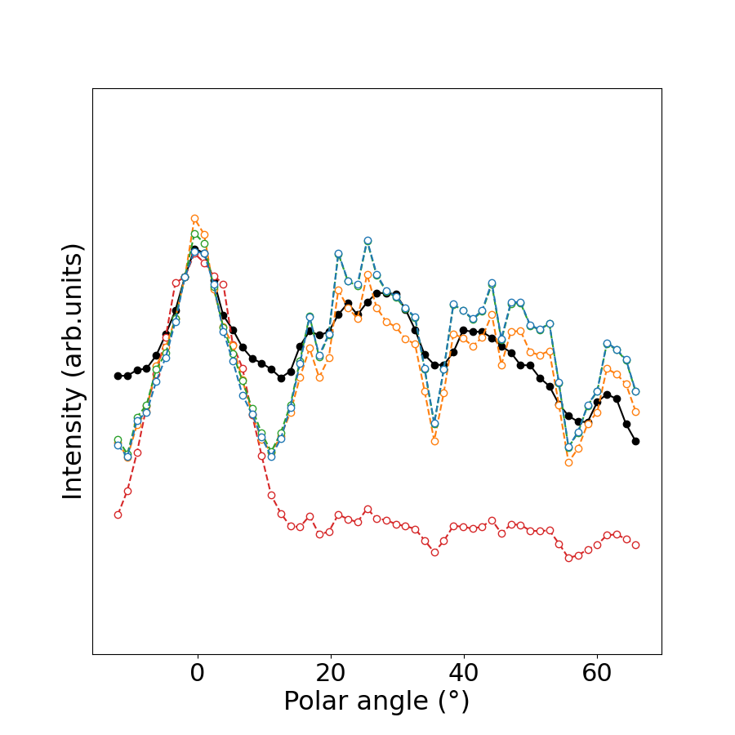
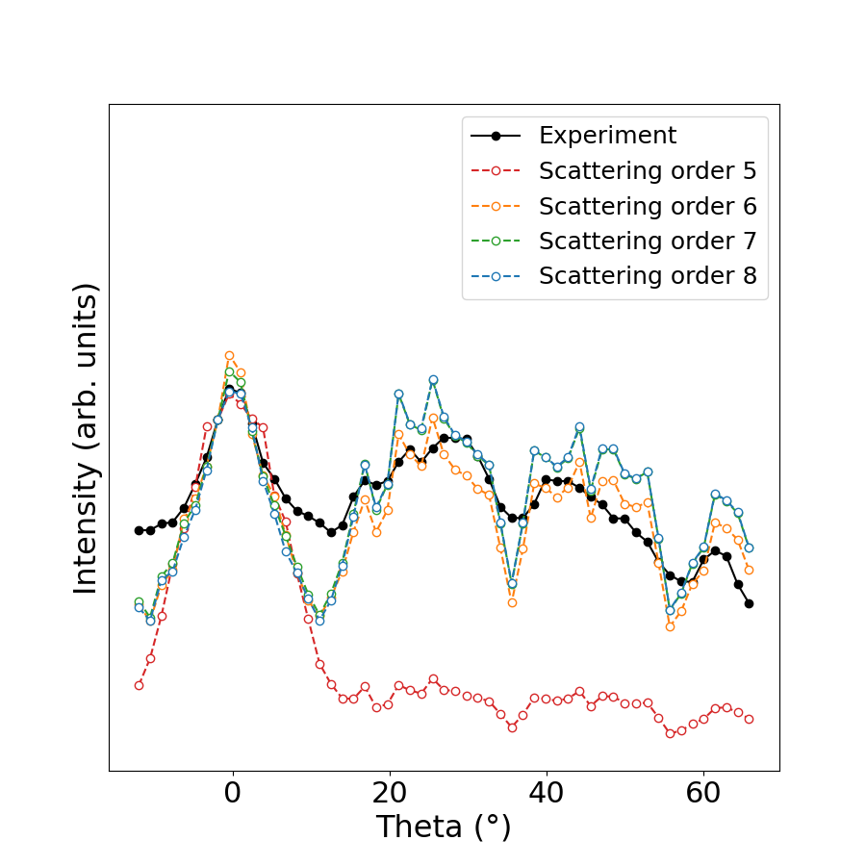
Simulation and Experiment
Renormalized
Computational time:
Order5: 6 mins
Order6: 7 mins
Order7: 40 mins
Order8: 17 hours
Scattering order 7, 8
Scattering order 6
Experiment by Bruno
Scattering order 5

Slide 4
Is theta scan valid for Ti-offset capturing ?
SrTiO₃ unit cell
In substrate, it has:
Ferroelectric phase transition at room temperature [1]
Sr
Sr
3,905 Å
Ti
Ti
Polarization (induced by the Ti offset)
O
O
Could we capture the Ti offset ?
3,905 Å
Small structural changes are responsible for essential properties.
To understand and/or control these properties, we need:
✓ Surface sensitivity
[1] Haeni, J. H., et al., Nature. 430 7001 (2004).
Notes:
まず本研究の対象物質について簡単に紹介します。
対象物質は、ペロブスカイトの一種であるチタン酸ストロンチウムです。
チタン酸ストロンチウムは、ストロンチウム原子、チタン原子、酸素原子からなり、常温では左の図の立方晶の単位格子を取ります。
物性の一つとして、基盤上で薄膜にした際に、常温で強誘電体へ転移することが挙げられます。これはTi原子のオフセットによって起きる自発分極が原因であると考えられている（XAS）。
このように、表面の微細な構造の変化が物性を変化させることがわかっていますが、サブÅスケールの構造変化を捉える、制御するためには、表面敏感な解析手法が有望であると考えられている。
Ti原子の変位、実験的観測：
強調版 日本語訳
ペロブスカイト構造結晶のX線Ti K吸収スペクトルにおける**プレエッジ微細構造（PEFS）**について、完全な解釈を提案する。本解釈は、修正版のフル多重散乱法を用いた多数の計算結果に基づいており、この方法により3d遷移金属酸化物に対する理論スペクトルが実験と良い一致を示すことが確認されている。
特に、中央のピークBはp–d混成効果によって生じ、その強度の大きさはペロブスカイト結晶の強誘電性の分光学的指標と考えられる。そして重要なのは、ピークBの面積が格子定数とTi原子の変位量（配位多面体の瞬間的な中心からの平均二乗変位）で直接的に表されるという点である。すなわち、Ti原子のわずかな変位が、分光学的に強誘電性の有無を決定する主要因となる。熱振動で平均化されたピークBの面積は、三体原子分布関数によって決まる。
一方、長波長側のピークAは主に四重極遷移に由来し、短波長側のピークCはTi 1s電子が隣接する遷移金属原子の空の3d状態へ遷移することに由来する。また、短波長側に追加ピークが現れる場合があり、これはZrのような4d原子がTi原子の周囲の酸素八面体に存在する場合に対応し、その面積は近傍4d原子数で決まる。
DyScO3: スカンジウム酸ジスプロシウム
BO3型のペロブスカイト構造と呼ばれる対称性の高い構造をとる。
タイトル、６０
化学
仮数、
polar discontinuity
alternately charged planes [LaO]+and[AlO2]−
AttheTiO2/LaO-terminated LAO/STO interface,therefore, each interfacial La transfers half of an electron intothe neighboring and formally neutral TiO2layer that decreasesthe oxidation state of interfacial Ti
All epitaxially grown perovskite heterostructures containintrinsic oxygen vacancies and substitutional cations near theinterfaces [14,15]. Interfacial defects may induce additionalcharged carriers
So as in the topic.
We are interested in the perovskites esp, Strontium Titanium Oxygen, or STO, because small changes in its structure are responsible for essential properties.
And it is of great technological importance.
The unit cell is a face-centred one, where we have 8 Srs at each vortex, 6 Oxygen at each centre of the faces and 1 Titanium in the centre.
Here is an example of 2-dimensional electron gas formation.
Firstly, on the left we have the iron and the STO layer and interface.
Secondly, oxygen migrates to the iron layer and we have oxidised irons and oxygen vacancies.
And if you look at the unit cell on the right, we have an oxygen vacancy and it causes the titanium to deviate upwards.
However, to understand and control such a property we need accurate crystallographic information, chemical resolution and surface sensitivity and the best way to do that is with X-ray photoelectron diffraction, called XPD.

Slide 5
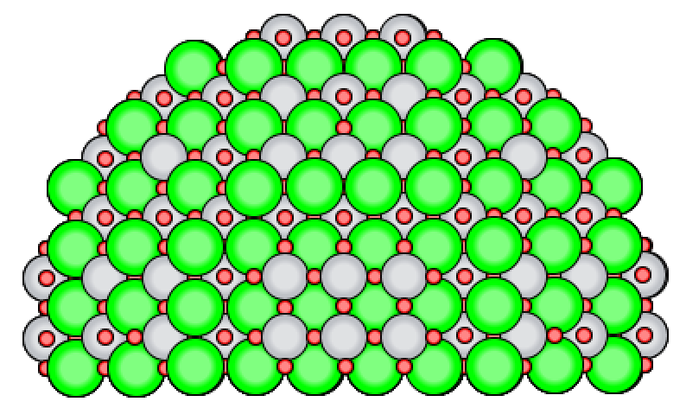
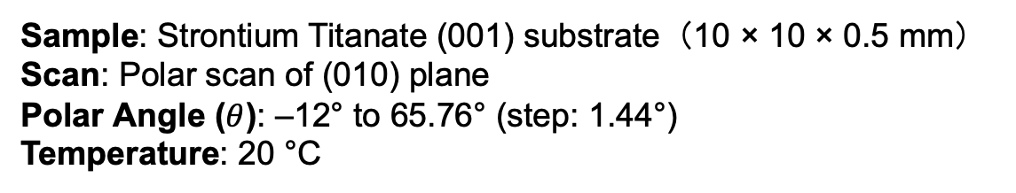
Simulation and experimental setups
x
Cluster
Ti offset: -0.2Å, -0.1Å, 0Å, +0.1Å, +0.2Å
Renormalized Series expansion (Scattering order 7)
※The other parameters are the same
: Sr
: Ti
: O
1920 atoms
Experimental conditions:
Sample: Strontium Titanate (001) substrate（10 × 10 × 0.5 mm） Scan: Polar scan of (010) plane Polar Angle ($θ$): –12° to 65.76° (step: 1.44°) Temperature: 20 °C

Slide 6
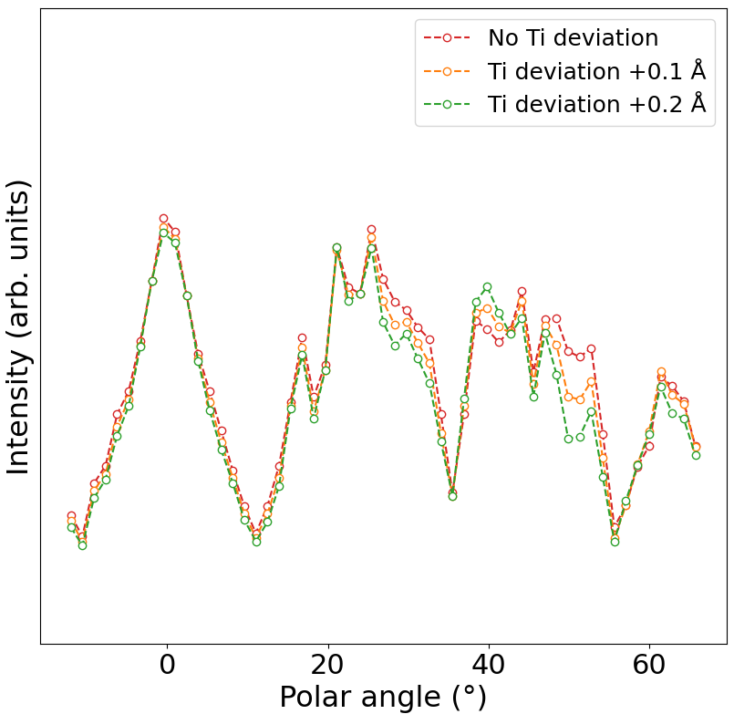
Simulation and Experiment
Renormalized
down
down
up
down
down
down
down
down

Slide 7
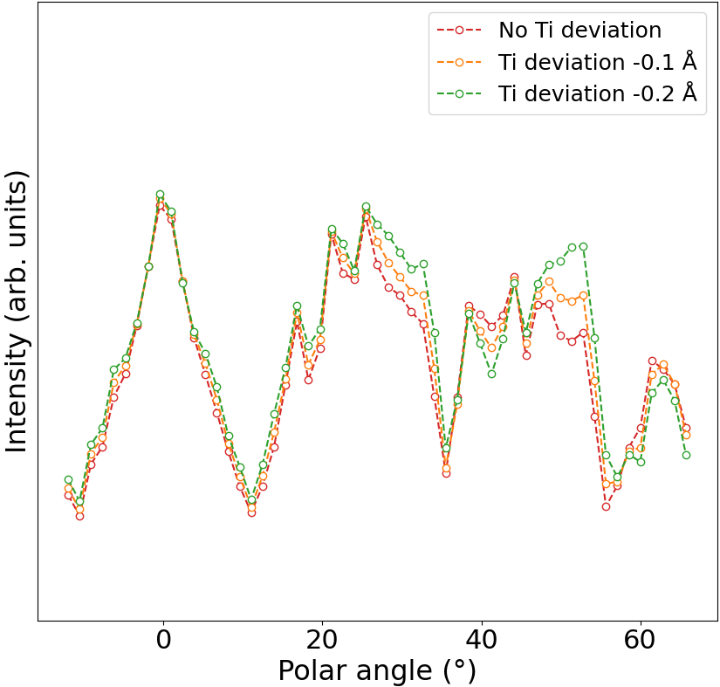
Simulation and Experiment
Renormalized
up
up
up
up
up
down
down
up
up
down
up

Slide 8
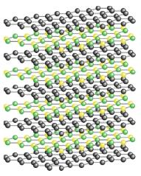
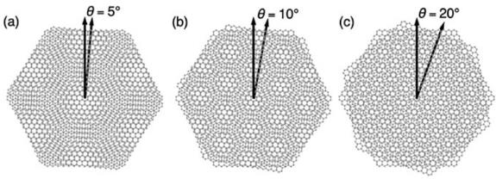
Vdw heterostructures
VdW heterostructures are layered materials by Van deer Waals force.
Photoelectron diffraction is a powreful tool for structural determination…
[2] S. Tricot et al., J. Electron Spectrosc. Relat. Phenom. 280 147524 (2025
vdW heterostructure
Moire superlattices
Solar cells [2], Light Emitting Diodes (LEDs) [3], Li-ion Batteries (LIBs) [4]
[2] X. Shen et al., Nano-Micro Lett. 16 201 (2024).
[3] P. Kumar. et al., ECS J. Solid State Sci. Technol. 5 Q321-Q3025 (2016). (DOI: 10.1149/2.0051611jss)
[4] X. Zhang. et al., ACS Appl. Mater. Interfaces. 16 68724-68748 (2024). (DOI: https://doi.org/10.1021/acsami.4c13135)

Slide 9
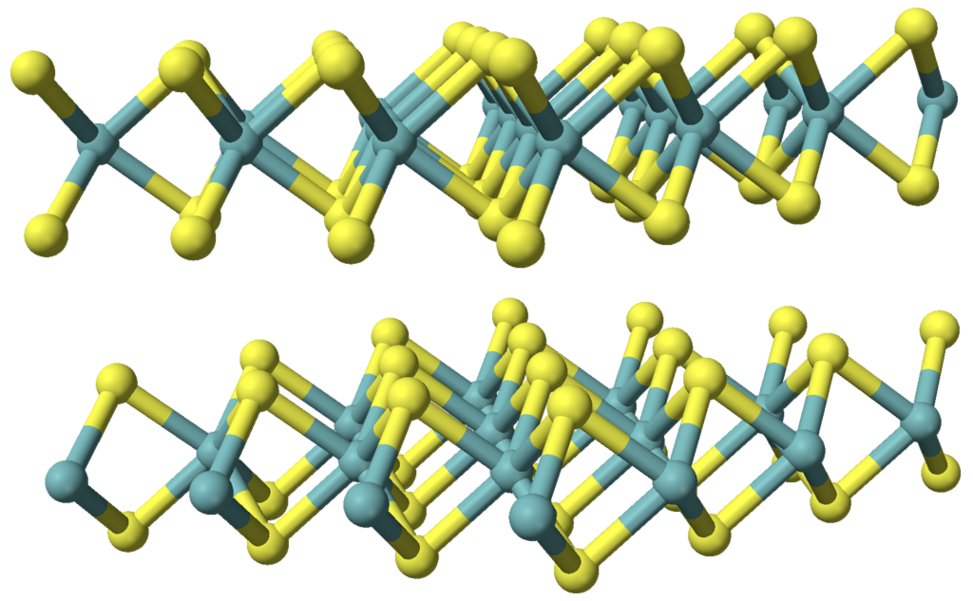
MoS2 bilayer
: Mo
: S
[5] Wikipedia. “Molybdenum disulfide.” Wikimedia Foundation. Accessed October 2, 2025. https://en.wikipedia.org/wiki/Molybdenum_disulfide.

Slide 10
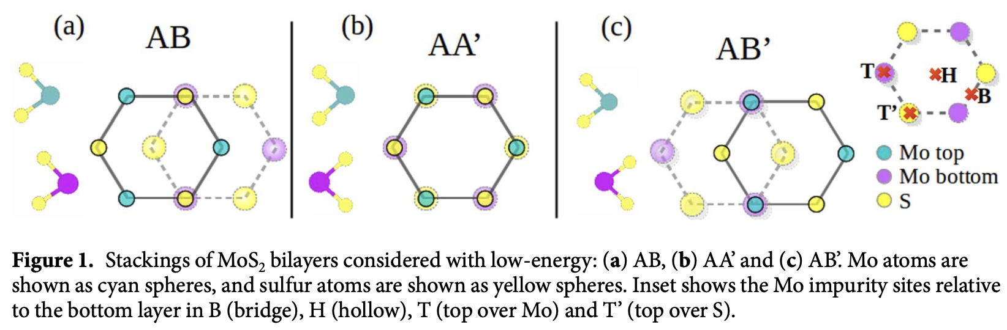
MoS2 bilayer - stable stackings -
Some stable stackings are calculated by DFT [5]:
※ Figure 1. cited from [6]
Stable order: AA’ (most stable, 2H) → AB (3R) → AB’ (2H)
[6] N. Cortés et al., Sci Rep. 8 2143 (2018).
Notes:
AA’ where every Mo atom in the bottom layer is just below S atom in the top layer and vice versa.
If we see the stacking from the z-direction, two layers are completely overlapped.
In AB stacking, every Mo atom in the bottom layer is just below S atom in the top layer but S atom is in just the center of a hexagonal in the top layer.
In AB’ stacking, every Mo atom in top and bottom layers are aligned but S atom is in the center of the hexagonal in the top.

Slide 11
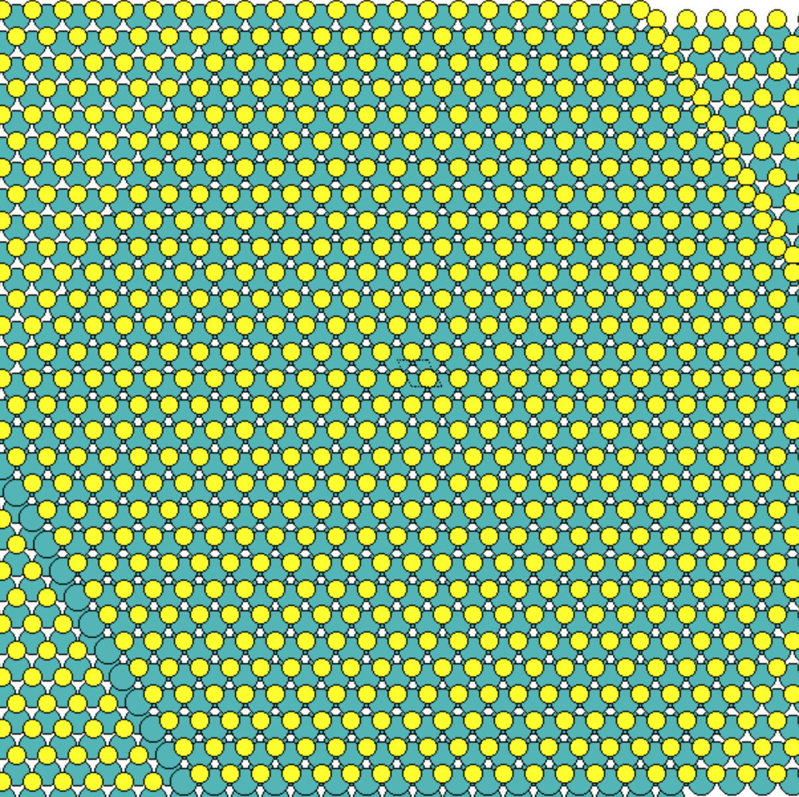
MoS2 bilayer - calculation model -
AA’:
unit vector:
2 Mo atoms are included.
One is in the top and the other is in the bottom layer.

Slide 12
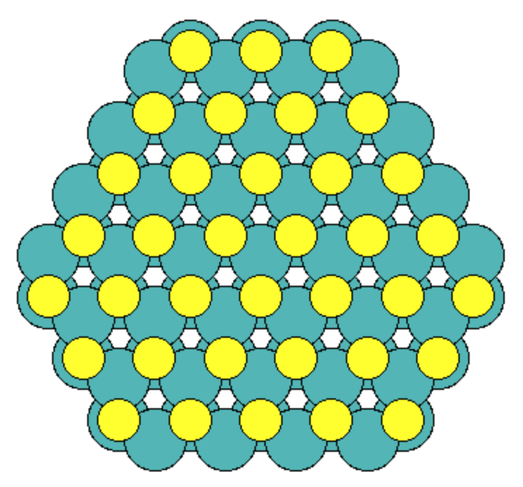
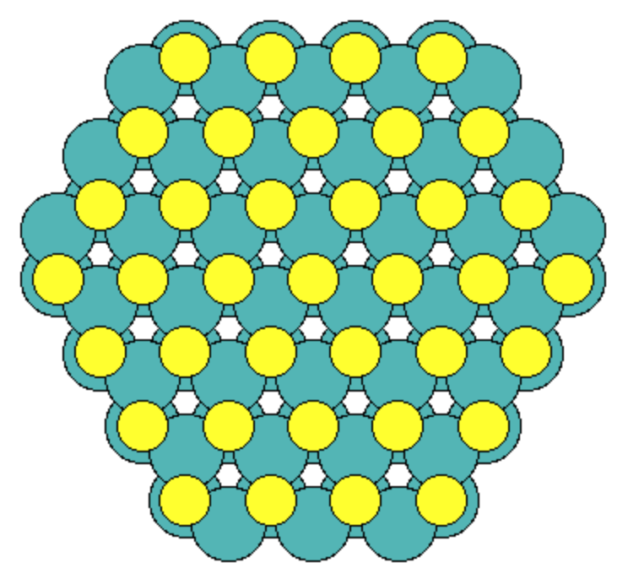
MoS2 bilayer - two clusters based on the 2 emitters -
Mo emitter at the top
Mo emitter at the bottom
Located at the bottom
Tests for AA’:
Cluster radius: 10, 15, and 20 Å
Method: Series expansion (Scattering order 1)

Slide 13
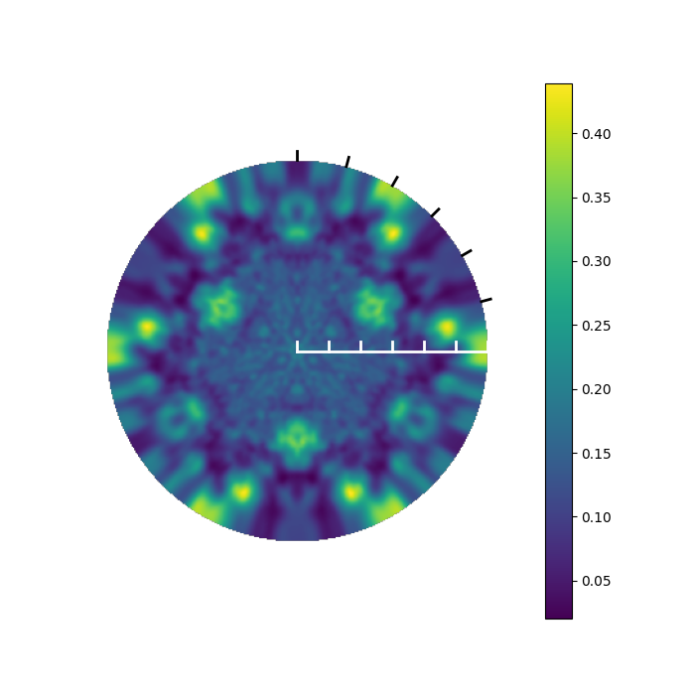
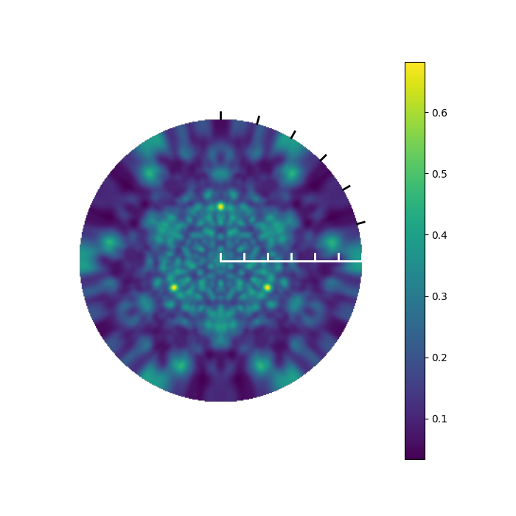
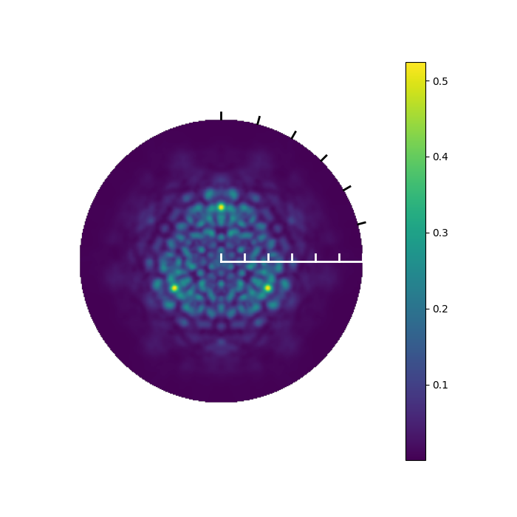
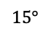
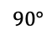
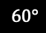
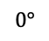
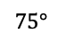
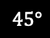
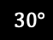
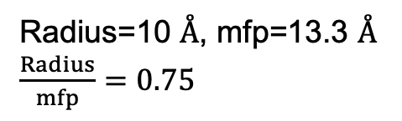
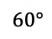
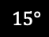
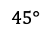
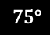
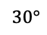
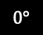
Simulation - AA’ stacking with radius 10 Å -
Radius=10 Å, mfp=13.3 Å
$\frac{Radius}{mfp}=0.75$
$$90°$$
$$75°$$
$$60°$$
$$45°$$
$$30°$$
$$15°$$
$$0°$$
$$15°$$
$$30°$$
$$45°$$
$$60°$$
$$75°$$
$$0°$$
top emitter
sum
bottom
Notes:
Height: 5.49 Width: 5.11

Slide 14
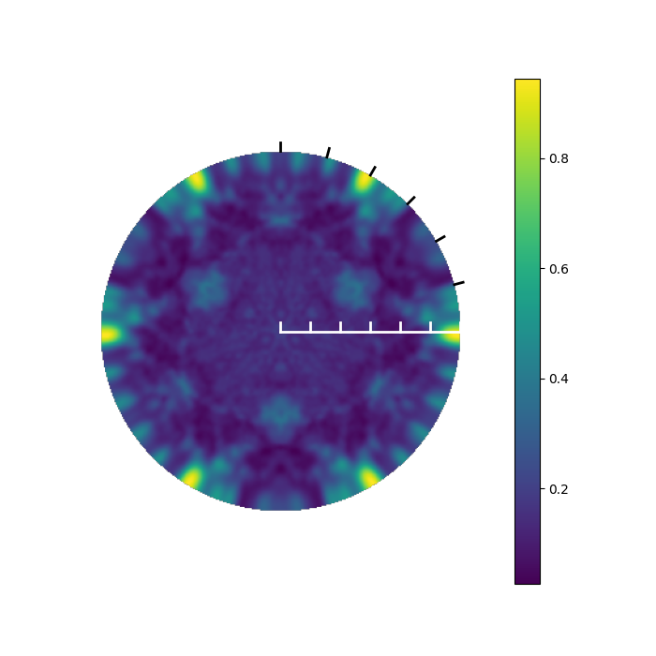
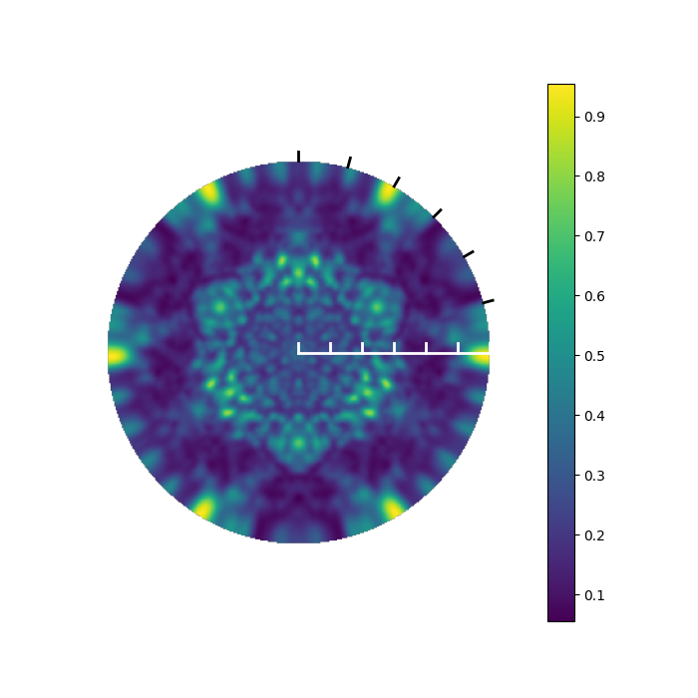
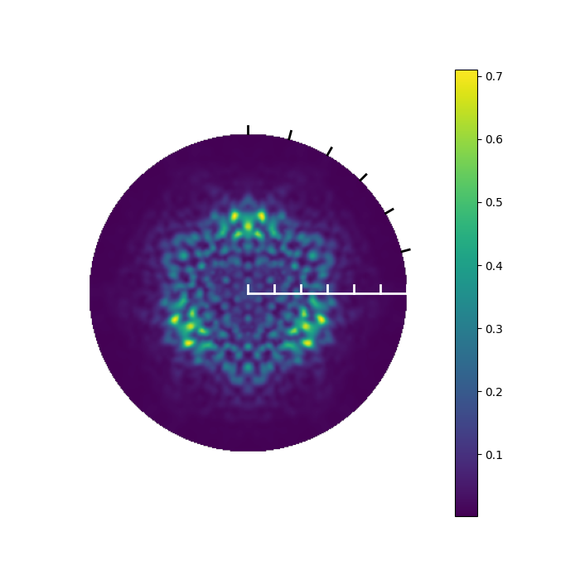
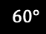
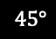
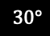
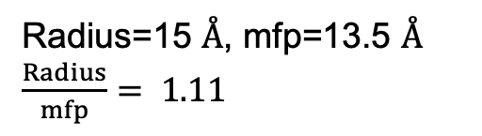
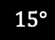
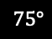
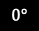
Simulation - AA’ stacking with radius 15 Å -
Radius=15 Å, mfp=13.5 Å
$\frac{Radius}{mfp}= 1.11$
$$90°$$
$$75°$$
$$60°$$
$$45°$$
$$30°$$
$$15°$$
$$0°$$
$$15°$$
$$30°$$
$$45°$$
$$60°$$
$$75°$$
$$0°$$
top emitter
sum
bottom
Notes:
Height: 5.49 Width: 5.11

Slide 15
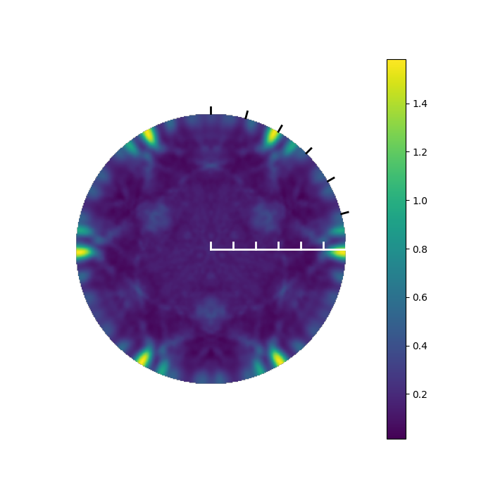
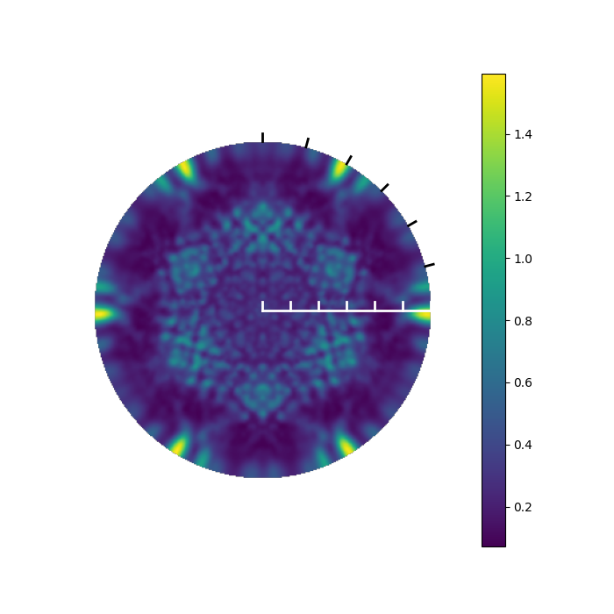
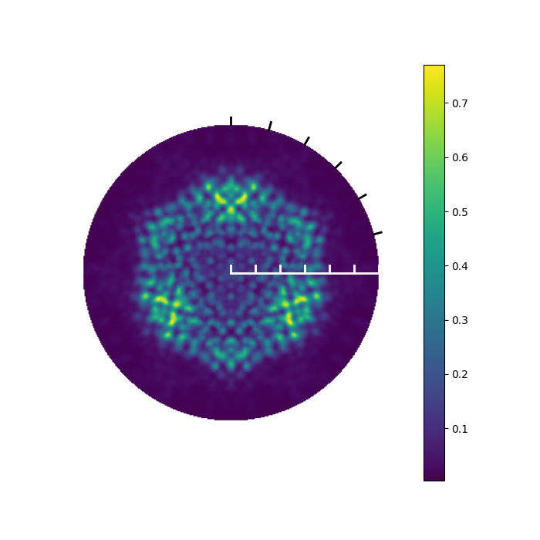
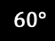
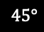





Simulation - AA’ stacking with radius 20 Å -
Radius=20 Å, mfp=13.8 Å
$$\frac{Radius}{mfp}=0.75$$
$$90°$$
$$75°$$
$$60°$$
$$45°$$
$$30°$$
$$15°$$
$$0°$$
$$15°$$
$$30°$$
$$45°$$
$$60°$$
$$75°$$
$$0°$$
top emitter
sum
bottom
Notes:
Height: 5.49 Width: 5.11

Slide 16

MoS2 bilayer - calculation model -
AB:
unit vector:
2 Mo atoms are included.
One is in the top and the other is in the bottom layer.

Slide 17


MoS2 bilayer - two cluster based on the 2 emitters -
Mo emitter at the top
Mo emitter at the bottom
Located at the bottom
Tests for AB’:
Cluster radius: 10, 15, and 20 Å
Method: Series expansion (Scattering order 1)

Slide 18










Simulation - AB stacking with radius 10 Å -
Radius=10 Å, mfp=13.3 Å
$$\frac{Radius}{mfp}=0.75$$
$$90°$$
$$75°$$
$$60°$$
$$45°$$
$$30°$$
$$15°$$
$$0°$$
$$15°$$
$$30°$$
$$45°$$
$$60°$$
$$75°$$
$$0°$$
top emitter
sum
bottom
Notes:
Height: 5.49 Width: 5.11

Slide 19

















Simulation - AB stacking with radius 15 Å -
Radius=15 Å, mfp=13.5 Å
$$\frac{Radius}{mfp}=1.11$$
$$90°$$
$$75°$$
$$60°$$
$$45°$$
$$30°$$
$$15°$$
$$0°$$
$$15°$$
$$30°$$
$$45°$$
$$60°$$
$$75°$$
$$0°$$
top emitter
sum
bottom
Notes:
Height: 5.49 Width: 5.11

Slide 20











Simulation - AB stacking with radius 20 Å -
Radius=20 Å, mfp=13.8 Å
$$\frac{Radius}{mfp}=1.45$$
$$90°$$
$$75°$$
$$60°$$
$$45°$$
$$30°$$
$$15°$$
$$0°$$
$$15°$$
$$30°$$
$$45°$$
$$60°$$
$$75°$$
$$0°$$
top emitter
sum
bottom
Notes:
Height: 5.49 Width: 5.11

Slide 21












Comparison of AA’ and AB stackings with radius 10 Å
top
$$90°$$
$$75°$$
$$60°$$
$$45°$$
$$30°$$
$$15°$$
$$0°$$
$$15°$$
$$30°$$
$$45°$$
$$60°$$
$$75°$$
$$0°$$
AA’
equivalent
AB
Notes:
Height: 5.49 Width: 5.11

Slide 22



Comparison of AA’ and AB stackings with radius 15 Å
top
$$90°$$
$$75°$$
$$60°$$
$$45°$$
$$30°$$
$$15°$$
$$0°$$
$$15°$$
$$30°$$
$$45°$$
$$60°$$
$$75°$$
$$0°$$
AA’
equivalent
AB
Notes:
Height: 5.49 Width: 5.11

Slide 23






Comparison of AA’ and AB stackings with radius 20 Å
top
$$90°$$
$$75°$$
$$60°$$
$$45°$$
$$30°$$
$$15°$$
$$0°$$
$$15°$$
$$30°$$
$$45°$$
$$60°$$
$$75°$$
$$0°$$
AA’
equivalent
AB
Notes:
Height: 5.49 Width: 5.11

Slide 24













Comparison of AA’ and AB stackings with radius 10 Å
bottom
$$90°$$
$$75°$$
$$60°$$
$$45°$$
$$30°$$
$$15°$$
$$0°$$
$$15°$$
$$30°$$
$$45°$$
$$60°$$
$$75°$$
$$0°$$
AA’
AB
Notes:
Height: 5.49 Width: 5.11

Slide 25






Comparison of AA’ and AB stackings with radius 15 Å
bottom
$$90°$$
$$75°$$
$$60°$$
$$45°$$
$$30°$$
$$15°$$
$$0°$$
$$15°$$
$$30°$$
$$45°$$
$$60°$$
$$75°$$
$$0°$$
AA’
AB
Notes:
Height: 5.49 Width: 5.11

Slide 26
Comparison of AA’ and AB stackings with radius 20 Å
bottom
$$90°$$
$$75°$$
$$60°$$
$$45°$$
$$30°$$
$$15°$$
$$0°$$
$$15°$$
$$30°$$
$$45°$$
$$60°$$
$$75°$$
$$0°$$
AA’
AB
Notes:
Height: 5.49 Width: 5.11

Slide 27
Comparison of AA’ and AB stackings with radius 10 Å
sum
$$90°$$
$$75°$$
$$60°$$
$$45°$$
$$30°$$
$$15°$$
$$0°$$
$$15°$$
$$30°$$
$$45°$$
$$60°$$
$$75°$$
$$0°$$
AA’
AB
Notes:
Height: 5.49 Width: 5.11

Slide 28
Comparison of AA’ and AB stackings with radius 15 Å
sum
$$90°$$
$$75°$$
$$60°$$
$$45°$$
$$30°$$
$$15°$$
$$0°$$
$$15°$$
$$30°$$
$$45°$$
$$60°$$
$$75°$$
$$0°$$
AA’
AB
Notes:
Height: 5.49 Width: 5.11

Slide 29
Comparison of AA’ and AB stackings with radius 20 Å
sum
$$90°$$
$$75°$$
$$60°$$
$$45°$$
$$30°$$
$$15°$$
$$0°$$
$$15°$$
$$30°$$
$$45°$$
$$60°$$
$$75°$$
$$0°$$
AA’
AB
Notes:
Height: 5.49 Width: 5.11

Slide 30
My thought
sum
Mo emitter at the bottom
$$90°$$
$$75°$$
$$60°$$
Located at the bottom
$$45°$$
$$30°$$
$$15°$$
$$0°$$
$$15°$$
$$30°$$
$$45°$$
$$60°$$
$$75°$$
$$0°$$
※ S atoms are emitted.
AA’
Notes:
Height: 5.49 Width: 5.11

Slide 31
My thought
sum
Mo emitter at the bottom
$$90°$$
$$75°$$
$$60°$$
Located at the bottom
$$45°$$
$$30°$$
$$15°$$
$$0°$$
$$15°$$
$$30°$$
$$45°$$
$$60°$$
$$75°$$
$$0°$$
AA’
Notes:
Height: 5.49 Width: 5.11

Slide 32
My thought
sum
Mo emitter at the bottom
$$90°$$
$$75°$$
$$60°$$
Located at the bottom
$$45°$$
$$30°$$
$$15°$$
$$0°$$
$$15°$$
$$30°$$
$$45°$$
$$60°$$
$$75°$$
$$0°$$
AB
Notes:
Height: 5.49 Width: 5.11

Slide 33


hidden Divergence
If we extract an atomic chain along x-axis from the cluster with the radius of 10 Å:
7 Mo atoms
$$ρ（K）=1.04$$
x
Series expansion diverges
We can not be sure if all the calculations are converged ones and precise…
We have to use renormalized expansion to see convergence.
Mo (emitter)
$ρ（G）=$0.77
3.16 Å
Future work:
I will re-calculate again but by renormalized expansion with an optimized omega, to get converged results.
Some forward filtering might be useful to reduce computation time (due to the high energy)
Notes:
Height: 5.49 Width: 5.11

Slide 34
Mo binding energy
Orbital (Binding energy (eV))
K: 1s (20000)
L
L1 : 2s (2866)
L2 : 2p₁/₂ (2625)
L3 : 2p₃/₂ (2520)
M
M1 : 3s (506.3)
M2 : 3p₁/₂ (411.6)
M3 : 3p₃/₂ (394)
M4 : 3d₃/₂ (231.1)
M5 : 3d₅/₂ (227.9)
N
N1 : 4s (63.2)
N2 : 4p₁/₂ (37.6)
N3 : 4p₃/₂ (35.5)
X-ray Source energy:
(Photoelectron kinetic energy) + (emitter binding energy ) + (work function)
~ a few eV, so negligible
600eV
231.1eV
600eV
+
231.1eV
= 831.1eV

